Slide 1

Efficient Parallel Algorithms for String Comparison
CS 309 - PROJECT
Authors: Nikita Mishin, Daniil Berezun, Alexander Tiskin
Made By:
Devansh Sahu (190001012)
Nimish Bansal (190001040)
Anikeit Sethi (190001003)
Deepkamal Singh (190001011)

Slide 2

Introduction::Longest Common Subsequence
LCS
a = a₁a_{i} ...a_{m}, b = b₁b₂...b_{n}
LCS (a, b) = |longest common subsequence|
a = CIPR, b = ICPP → LCS (a, b) = LCS (CIPR , ICPP ) = 2
a = BAABCBCA, b = BAABCABCABACA →
LCS (a, b) = LCS (BAABCBCA, BAABCABCABACA ) = 8
O(nm)

Slide 3
Preliminaries::sticky braid
Informal definition:
m + n monotone curves (called strands)
Neighboring strands can form a crossing Neighboring strands can cross at most once
{0 ->, 1 ->2, 2 ->4, 3 ->0, 4 -> 5, 5 ->3}

Slide 4
Preliminaries::sticky braid
Multiplication O((m + n) log(m + n)) — place one braid under another and untangle strands
P
=
=
R
Q

Slide 5
Introduction::semi-local LCS
8 | 8 | 8 | 8 | 8 | 8 | 8 | 8 | 8 | 8 | 8 | 8 | 8 | 8 | 8 | 8 | 8 | 8 | 8 | 8 | 8 | 8
7 | 7 | 8 | 8 | 8 | 8 | 8 | 8 | 8 | 8 | 8 | 8 | 8 | 8 | 8 | 8 | 8 | 8 | 8 | 8 | 8 | 8
6 | 6 | 7 | 7 | 7 | 7 | 8 | 8 | 8 | 8 | 8 | 8 | 8 | 8 | 8 | 8 | 8 | 8 | 8 | 8 | 8 | 8
5 | 6 | 7 | 7 | 7 | 7 | 8 | 8 | 8 | 8 | 8 | 8 | 8 | 8 | 8 | 8 | 8 | 8 | 8 | 8 | 8 | 8
4 | 5 | 6 | 6 | 6 | 6 | 7 | 7 | 7 | 8 | 8 | 8 | 8 | 8 | 8 | 8 | 8 | 8 | 8 | 8 | 8 | 8
3 | 4 | 5 | 5 | 5 | 6 | 7 | 7 | 7 | 8 | 8 | 8 | 8 | 8 | 8 | 8 | 8 | 8 | 8 | 8 | 8 | 8
2 | 3 | 4 | 4 | 4 | 5 | 6 | 6 | 7 | 8 | 8 | 8 | 8 | 8 | 8 | 8 | 8 | 8 | 8 | 8 | 8 | 8
1 | 2 | 3 | 3 | 4 | 5 | 6 | 6 | 7 | 8 | 8 | 8 | 8 | 8 | 8 | 8 | 8 | 8 | 8 | 8 | 8 | 8
0 | 1 | 2 | 3 | 4 | 5 | 6 | 6 | 7 | 8 | 8 | 8 | 8 | 8 | 8 | 8 | 8 | 8 | 8 | 8 | 8 | 8
-1 | 0 | 1 | 2 | 3 | 4 | 5 | 5 | 6 | 7 | 7 | 7 | 7 | 7 | 7 | 7 | 8 | 8 | 8 | 8 | 8 | 8
-2 | -1 | 0 | 1 | 2 | 3 | 4 | 4 | 5 | 6 | 6 | 6 | 6 | 7 | 7 | 7 | 8 | 8 | 8 | 8 | 8 | 8
-3 -2 -1 0 1 |  |  |  |  | 2 | 3 | 3 | 4 | 5 | 5 | 6 | 6 | 7 | 7 | 7 | 8 | 8 | 8 | 8 | 8 | 8
-4 -3 -2 -1 0 |  |  |  |  | 1 | 2 | 2 | 3 | 4 | 4 | 5 | 5 | 6 | 6 | 6 | 7 | 7 | 8 | 8 | 8 | 8
-5 -4 -3 -2 -1 |  |  |  |  | 0 | 1 | 2 | 3 | 4 | 4 | 5 | 5 | 6 | 6 | 6 | 7 | 7 | 8 | 8 | 8 | 8
-6 -5 -4 -3 -2 -1 |  |  |  |  |  | 0 | 1 | 2 | 3 | 3 | 4 | 4 | 5 | 5 | 6 | 7 | 7 | 8 | 8 | 8 | 8
-7 -6 -5 -4 -3 -2 |  |  |  |  |  | -1 | 0 | 1 | 2 | 2 | 3 | 3 | 4 | 4 | 5 | 6 | 7 | 8 | 8 | 8 | 8
-8 -7 -6 -5 -4 -3 -2 -1 |  |  |  |  |  |  |  | 0 | 1 | 2 | 3 | 3 | 4 | 4 | 5 | 6 | 7 | 8 | 8 | 8 | 8
-9 -8 -7 -6 -5 -4 -3 -2 |  |  |  |  |  |  |  | -1 | 0 | 1 | 2 | 3 | 4 | 4 | 5 | 6 | 7 | 8 | 8 | 8 | 8
-10 -9 -8 -7 -6 -5 -4 -3 -2 -1 |  |  |  |  |  |  |  |  |  | 0 | 1 | 2 | 3 | 3 | 4 | 5 | 6 | 7 | 7 | 7 | 8
-11 -10 -9 -8 -7 -6 -5 -4 -3 -2 |  |  |  |  |  |  |  |  |  | -1 | 0 | 1 | 2 | 2 | 3 | 4 | 5 | 6 | 7 | 7 | 8
-12 -11 -10 -9 -8 -7 -6 -5 -4 -3 -2 -1 |  |  |  |  |  |  |  |  |  |  |  | 0 | 1 | 2 | 3 | 4 | 5 | 6 | 7 | 7 | 8
-13 -12 -11 -10 -9 -8 -7 -6 -5 -4 -3 -2 |  |  |  |  |  |  |  |  |  |  |  | -1 | 0 | 1 | 2 | 3 | 4 | 5 | 6 | 7 | 8
a = BAABCBCA
b = BAABCABCABACA H[i, j ] = LCS (a, b[i : j ]) H(4, 11) = 5
11.08.20214 / 12

Slide 6
Introduction::semi-local LCS
Can be expressed via sticky braids objects of size n + m
⁾ Embeddings into LCS grid
^{Ç} rotate braid by 45 degrees anti-clockwise
^{Ç} symbol matches – barrier for strands to intersect
⁾ Two approach:
^{Ç} Divide-and-conquer: split into smaller braids; to concatenate apply sticky braid multiplication
^{Ç} DP: process cell-by-cell and cross strands if needed
⁾ O(nm)

Slide 7
Introduction::semi-local LCS
m+n−1
m+n−1
2
1
0
0 1 2

Slide 8
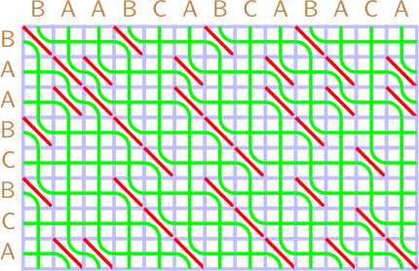
Implementation::DP

Slide 9
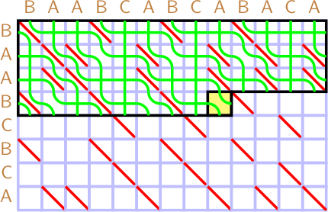
Implementation::DP
if (a_symb = b_symb) || (h_strand > v_strand))
swap(h_strand, v _strand )

Slide 10
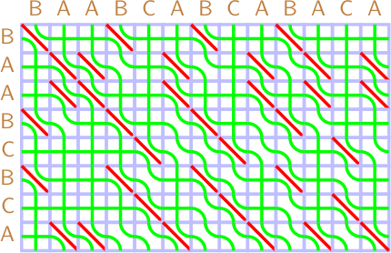
Implementation::DP

Slide 11
Implementation::Recursive

Slide 12
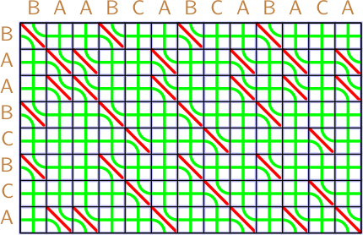
Implementation::Recursive

Slide 13
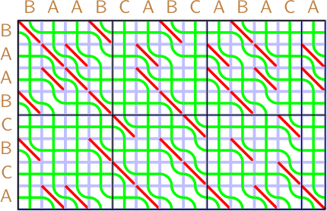
Implementation::Recursive

Slide 14
Implementation::Recursive
Processor-level parallelism
Efficient memory management:
⁾ No malloc inside function
⁾ Reuse of space from outer levels
Precalc product of permutations up to some N:
⁾ Small permutations fit to one machine word
⁾ N! * N! pairs for N
⁾ Lookup to map pair (p, q)

Slide 15
Implementation:: Combine two approaches
Eliminate outer recursion:
⁾ Split into fixed-size subproblem: m_{i} + n_{i} < 2¹⁶
⁾ One thread per problem
⁾ Then apply sticky braid multiplication in parallel fashion

Slide 16
Implementation:: Bit-parallel prefix LCS
Bit-parallel prefix LCS for binary strings:
⁾ Hyyr¨o, Crochemore et al.
⁾ Integer addition
⁾ Therefore, carry propagation

Slide 17
Implementation:: Bit-parallel prefix LCS for binary strings
Idea
1 for horizontal strands, 0 for vertical
Most significant bit first for a and horizontal strands Least significant bit first for b and vertical strands
Shifts for word alignment, Boolean operators for cell logic Process in antidiagonal tiles
LCS (a, b) = |a|− set bits in h

Slide 18
Implementation:: Bit-parallel prefix LCS for binary strings
Example
w = 4
a = 1000, b = 0100
Encoding:
⁾ a′ = 1000₂, b′ = 0010₂
⁾ h = 1111₂, v = 0000₂

Slide 19


Implementation:: Bit-parallel prefix LCS for binary strings
O I O O
O I O O
O I O O
O I O O
I O O O
I O O O
I O O O
I O O O
h = 1111
v = 0000
h = 0011
v = 1100
O I O O
h = 0111
v = 1000
O I O O
h = 0011
v = 1010
O I O O
O I O O
I O O O
I O O O
I O O O
I O O O
h = 0011
v = 1010
h = 0001
v = 1011
h = 0001
v = 1011
h = 0001
v = 1011

Slide 20
Implementation:: Bit-parallel prefix LCS for binary strings
Processing of second antidiagonal (18 op): Compare characters: s =!((a′ ≫ 2) ⊕ b)
Active bits: mask = 0011₂ (compile time)
Combing condition: c = mask & (s | (!(h ≫ 2) & v ))
save v ′ = v
update v = (!c & v ) | (c & (h ≫ 2)) update c = c ≪ 2
update h = (!c & h) | (c & (v′ ≪ 2))

Slide 21
Implementation:: Bit-parallel prefix LCS for binary strings
Processing of second antidiagonal (18 op):
Compare characters: s =!((1000₂ ≫ 2) ⊕ 0010₂) = 0011₂
Active bits: mask = 0011₂ (compile time)
Condition: c = 0011₂ & (0011₂ | (!(1111₂ ≫ 2) & 0000₂)) = 0011₂
v ′ = 0000₂
v = (!0011₂ & 0000₂) | (0011₂ & (1111₂ ≫ 2)) = 0011₂ (1100)
c = 0011₂ ≪ 2 = 1100₂
h = (!1100₂ & 1111₂) | (1100₂ & (0000₂ ≪ 2)) = 0011₂ (0011)

Slide 22
Implementation:: Bit-parallel prefix LCS for binary strings
Processing of second antidiagonal (11 op):
Compare string characters: s = ((a′′ ≫ 2) ⊕ b)
v ′ = v
v = ((h ≫ 2) | !mask) & (v | (s & mask))
h = h ⊕ (v ≪ 2) ⊕ (v′ ≪ 2).
11.08.20219 / 12

